Slide 1
Network Address Translation
(NAT)
Avinash Gautam
Internet Technology
20020570009

Slide 2
What is NAT ?
Network Address Translation (NAT) is a process in which one or more local IP address is translated into one or more Global IP address and vice versa in order to provide Internet access to the local hosts.
Also, it does the translation of port numbers i.e. masks the port number of the host with another port number, in the packet that will be routed to the destination. It then makes the corresponding entries of IP address and port number in the NAT table.
NAT generally operates on a router or firewall.

Slide 3
Working of NAT
Generally, the border router is configured for NAT i.e the router which has one interface in the local (inside) network and one interface in the global (outside) network.
When a packet traverse outside the local (inside) network, then NAT converts that local (private) IP address to a global (public) IP address.
When a packet enters the local network, the global (public) IP address is converted to a local (private) IP address.
If NAT runs out of addresses, i.e., no address is left in the pool configured then the packets will be dropped and an Internet Control Message Protocol (ICMP) host unreachable packet to the destination is sent.

Slide 4
NAT Addresses
There are 4 types of address :
Inside Local ( Sender in a Network )
Outside Local (Recipient in a Different Network )
Inside Global ( Senders’ Router )
Outside Global ( Recipients’ Router / Hub)

Slide 5
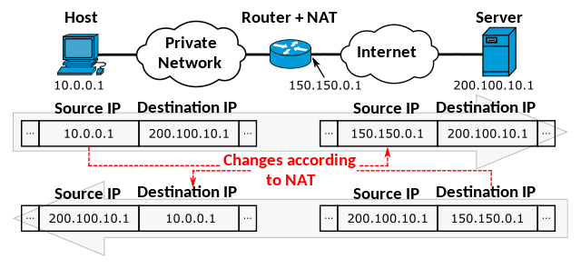

Slide 6
Types of NAT
There are 3 types of NAT :
Static NAT ( one to one )
Dynamic NAT ( first come first serve )
Port Address Translation (PAT) ( many to one )
PAT is known as NAT Overload.

Slide 7
Advantages of NAT
NAT conserves legally registered IP addresses.
It provides privacy as the device’s IP address, sending and receiving the traffic, will be hidden.
Eliminates address renumbering when a network evolves.

Slide 8
Disadvantages of NAT
Translation results in switching path delays.
Certain applications will not function while NAT is enabled.
Complicates tunneling protocols such as IPsec.
Also, the router being a network layer device, should not tamper with port numbers(transport layer) but it has to do so because of NAT.

Slide 9
Thank
You

